Slide 1
Markov Decision Process Implementation and Policy Iteration
Devin Elmore, Daryl Nguyen, Thomson Nguyen, Kenneth Valero, Steven Yacoub

Slide 2
Introduction
Markov Decision Process (MDP):
A sequential decision process based on: a set of states, a set of actions, a transition function, a reward function, and a start state
The solution of an MDP is a policy which is a set of actions an agent should take at any state.
An optimal policy is one that maximizes expected utility
The policy iteration algorithm alternates between policy evaluation and policy improvement

Slide 3
Data Sets and Features
The dataset appears as a 4 by 4 square grid with 16 possible states:
The locations of each feature are as follows:
Agent: [1. 1]
Wumpus Monster: [1, 3]
Pits: [3,1], [3, 3] & [1, 4]
Gold: [2, 3}
Stench: [1, 2], [1, 4], & [2, 3]
Breeze: [2, 1], [2, 3], [3, 2], [3, 4], [4, 1] & [4, 3]
For our project purposes, the cells for Gold, Stench, and Breeze are to be ignored completely

Slide 4
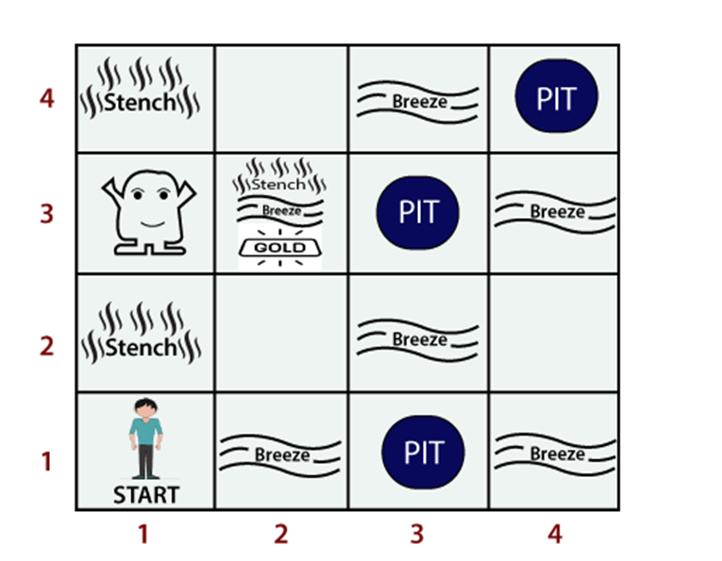
The Wumpus World Cave Problem
Wumpus: Reward of -1000
Gold: Reward of +1000
Pits: Agent cannot enter information

Slide 5
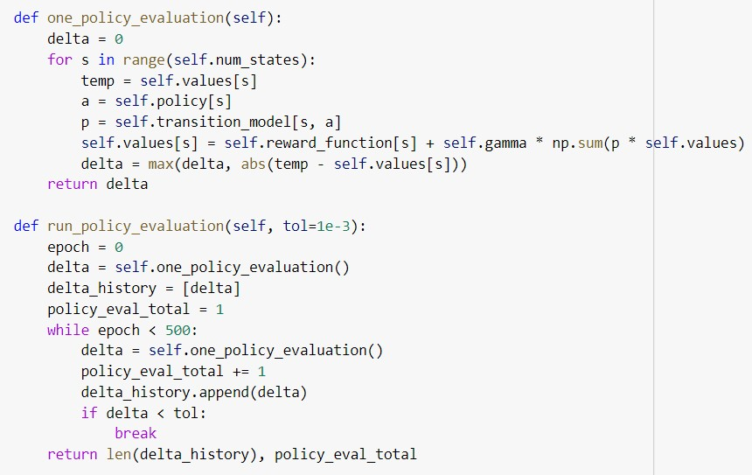
Methods (Policy Evaluation)
At the start of each iteration, each cell’s utility is calculated (Excluding Wumpus, Gold, and Pit cells)
Calculation focused on immediate reward
Reinforcement learning type

Slide 6
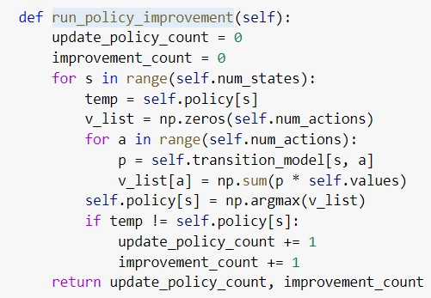
Methods (Policy Improvement)
Occurs directly after policy evaluation
Updates the current policy based on the actions that produce the highest rewards.

Slide 7
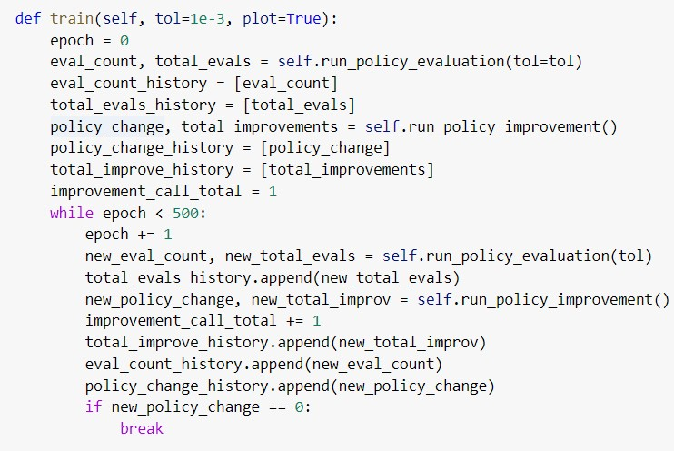
Methods (Training Algorithm)
Repeatedly calls policy evaluation and policy improvement functions
Stops once the model reaches convergence where changes become minimal

Slide 8
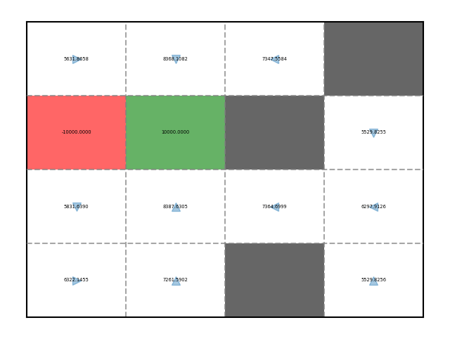
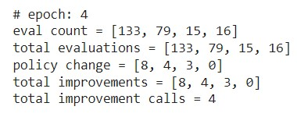
Experiments and Results
Policy evaluation was conducted 243 times, policy improvement was conducted 4 times, and updates to actions were conducted 15 times:
After training the optimal policy for the model was produced (see below):

Slide 9
Conclusion
MDP created to form an optimal Wumpus World policy
2 key steps in the cycle:
Policy evaluation performed until utility values converge
Policy improvement to update assigned actions for each empty cell
Policy iteration was able to find a policy that would avoid Wumpus while progressing towards gold
Future work: modifying the policy improvement algorithm to also take into account distance from gold tile after taking action

Slide 10
References
[1] Arooj Fatima. What is the Wumpus World in artificial intelligence? Retrieved May 1, 2023 from https://www.educative.io/answers/what-is-the-wumpus-world-in-artificial-intelligence
[2] Russell, S. J., & Norvig, P. (2016). Sequential Decision Problems. In Artificial Intelligence: A Modern Approach. essay, Pearson.

